Slide 1
Name: Kshitiz Acharya
Student Id: K201032

Slide 2

Functional Requirement
User
User registration
User Login
Car search Option
View Car Categories
Choose Filter Options
View Vehicle Information
Watch Videos
Make a Purchase
Create Loan Application
Create a Booking
Create Customer profile
Create a payment
View Shopping Cart
Create Feedbacks and Reviews
View Notifications Alert
Add to Wishlist
Create History and Records
Use Price Calculator
Make Pre-order/Reserve Request
Create Order Inquiry
Create a Refund Request
Use AI API Chatbot

Slide 3
Functional Requirement
Admin
Admin Login
View Dashboard
Create Scheduling Tasks
View Vehicle Inventory
View Available Vehicles
View Stock Levels
Generate Notification Alert
Manage order
View Bookings
View Bookings
Manage users
Manage Accessories
Manage Shipping
Maintain Records
Manage Payment
Create Vendor Invoice
Manage Refund Request

Slide 4
Non-Functional Requirements
Security
Login
Password
Availability
System uptime
Backup and recovery
Performance
Response time
Scalability
Accessibility
Cross Browser combability
Compliance with Accessibility Standards
Scalability
Load balancing
Horizontal and vertical scalability
Usability
Responsive Design
User Interface
Reliability
Error handling
Functional requirements
Authorization
Guided instructions

Slide 5
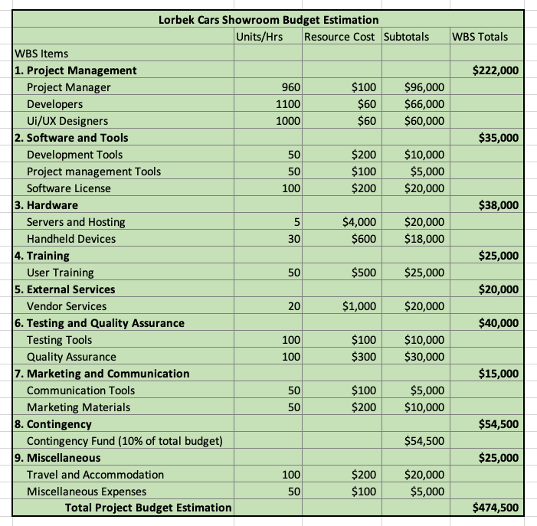
Budget Allocation

Slide 6
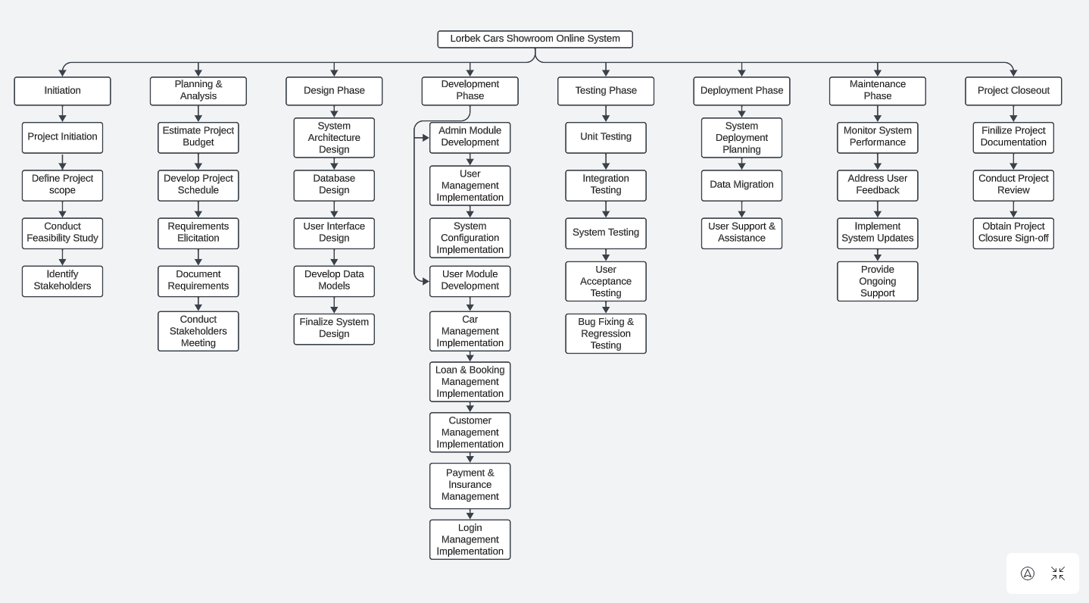
Work Breakdown Structure

Slide 7
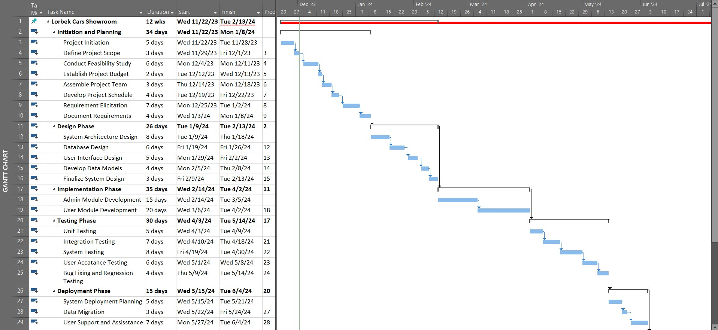
Gantt Chart

Slide 8
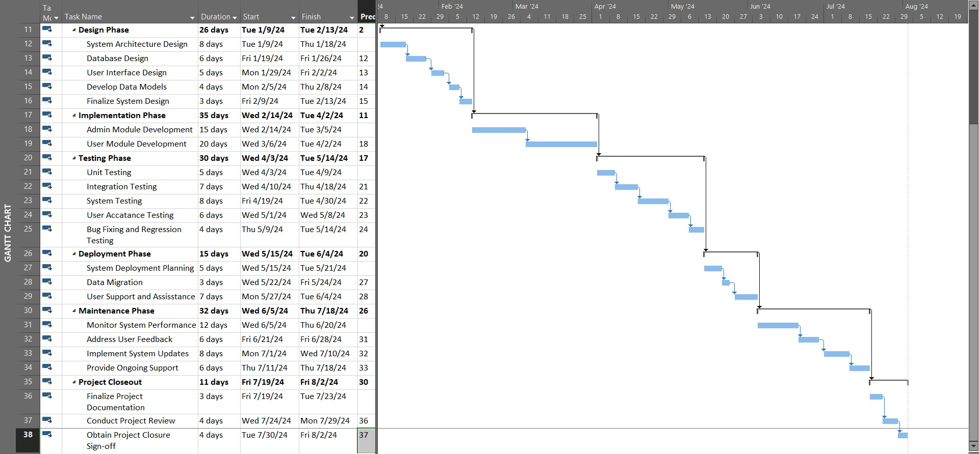
Gantt Chart

Slide 9
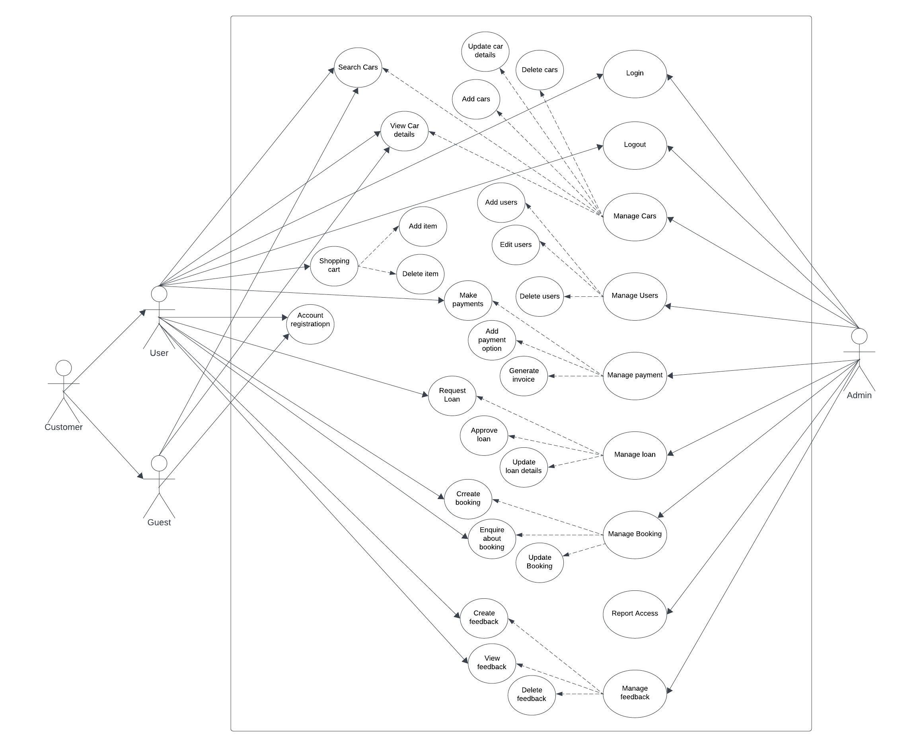
Use Case Diagram

